Slide 1
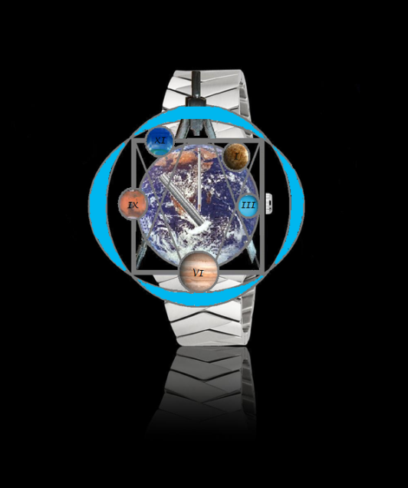
Another BREIL watch
DESIGN TIME
Music: Terra Aria Giovanni Sollima

Slide 2
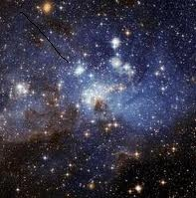
TIME a movement in space

Slide 3
Mother earth and Planets

Slide 4
Earth

Slide 5
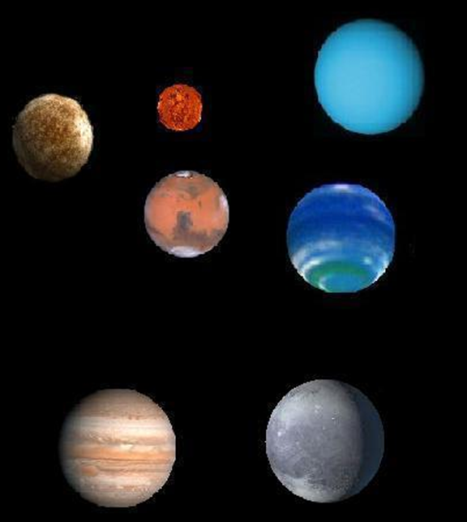
Planets

Slide 6
Design …. point - line

Slide 7
Another BREIL watch used for design EMIT

Slide 8
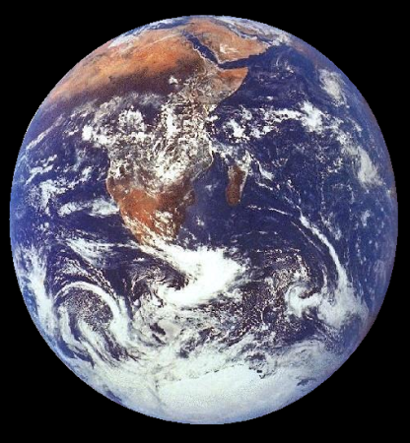
Mother earth from out of space
Mother earth from out of space

Slide 10
watch hands

Slide 15
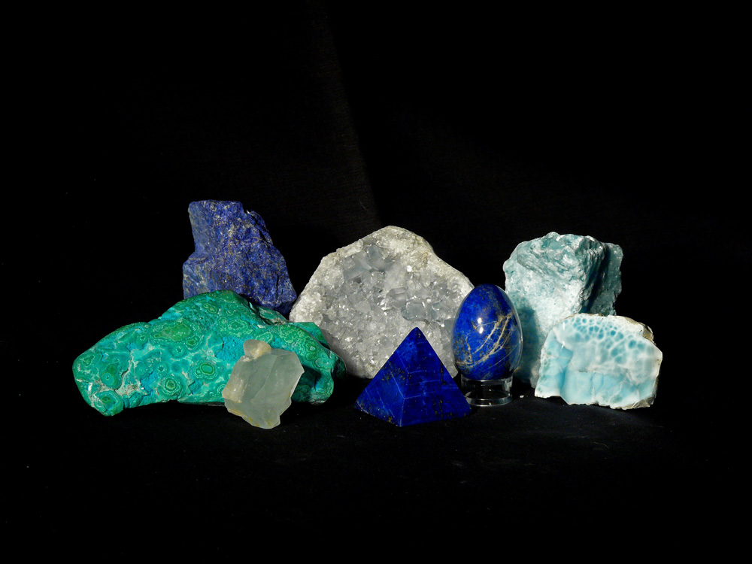

Slide 17
Design …. point - line - circle

Slide 18
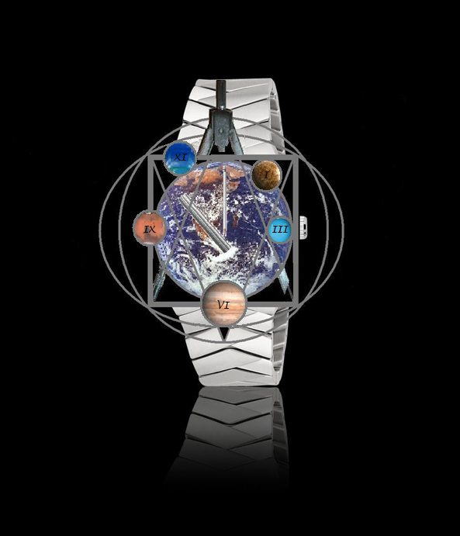

Slide 19
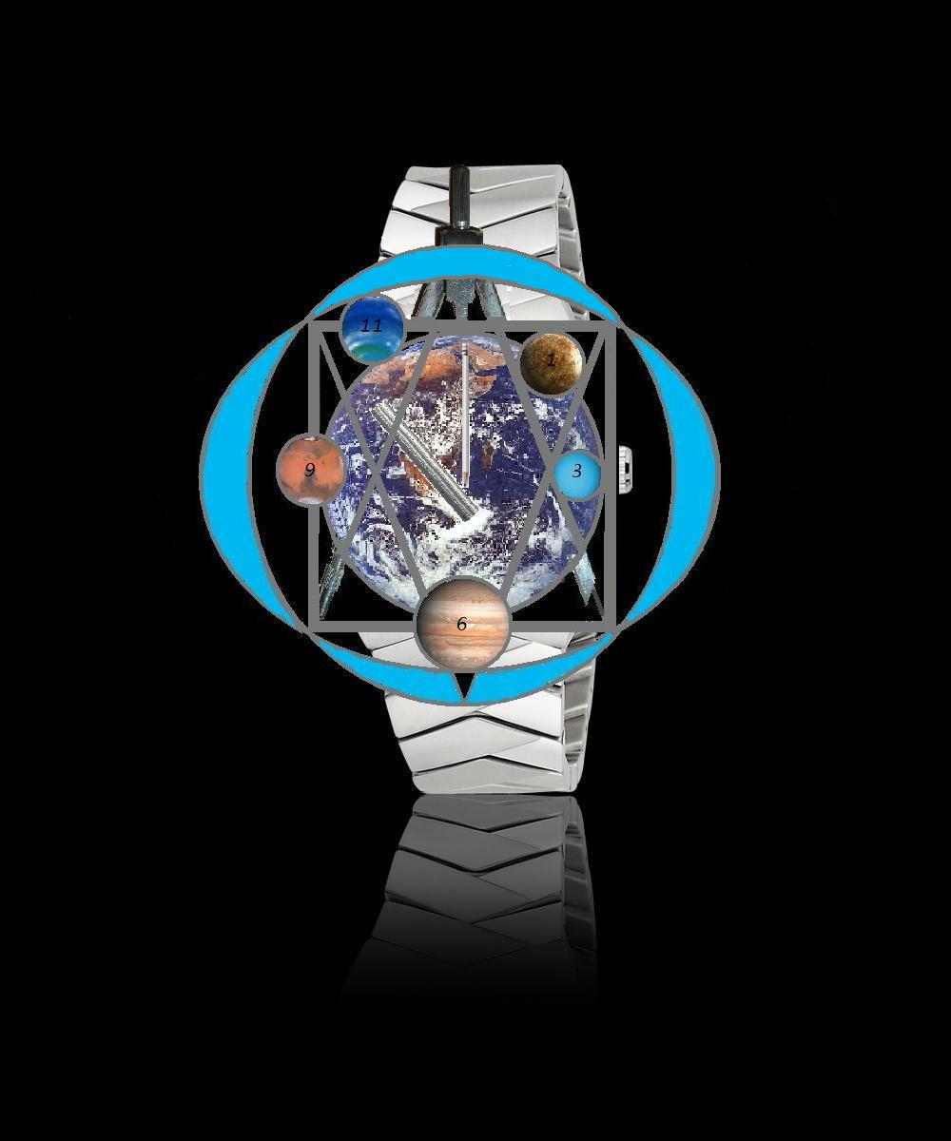
Time as an ornament

Slide 20
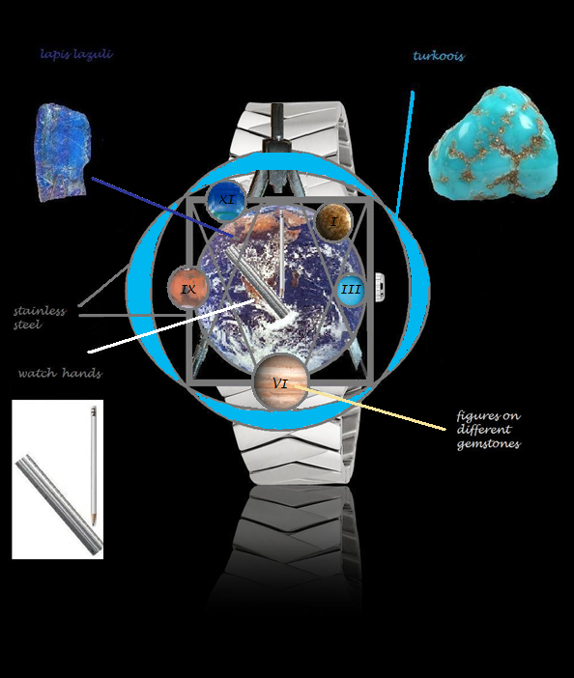
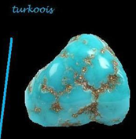
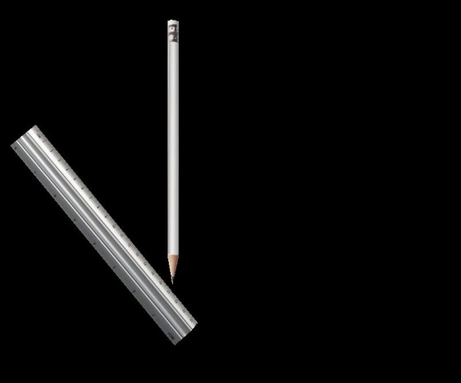
Time as an ornament

Slide 21
TIME as an ornament

Slide 22
EMIT
another BREIL watch
May 2011
by Erica Rekers

